Slide 1




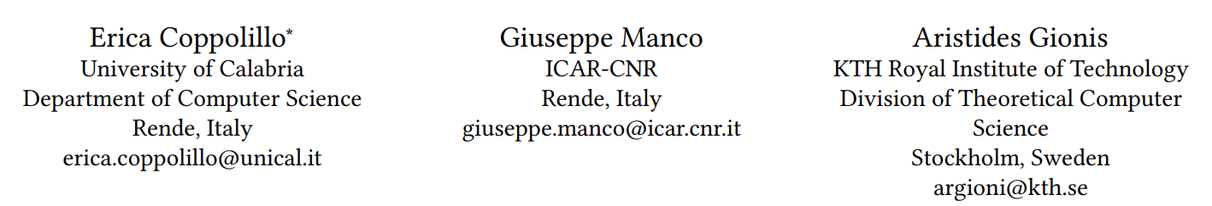





ATAI
Advanced Techniqueof Artificial Intelligence
ATAI
ChongqingUniversity _{AdvancedTechniqueof}
of Technology Artificial Intelligence
Chongqing University of
Technology
Chongqing University ^{ATAI}
_{of Technology} Advanced Techniqueof
Artificial Intelligence
Chongqing University of Technology
Chongqing University of Technology
Relevance Meets Diversity: A User-Centric Framework
for Knowledge Exploration Through Recommendations
Code: https://github.com/EricaCoppolillo/EXPLORE
2024.10.24•ChongQing
—— KDD 2024
Reported by Shunan Yin
1

Slide 2

ATAI
AdvancedTechniqueof
Artificial Intelligence
ATAI
ChongqingUniversity _{AdvancedTechniqueof}
of Technology Artificial Intelligence
ChongqingUniversity of Technology
Motivation
Providing recommendations that are both relevant and diverse is a key consideration of modern recommender systems. Optimizing both of these measures presents a fundamental trade-off, as higher diversity typically comes at the cost of relevance, resulting in lower user engagement.
In contrast to applications where the goal is solely to maximize engagement, we focus on scenarios aiming at maximizing the total amount of knowledge encountered by the user.
To achieve a balance between relevance and diversity, current methods merge these two metrics into a single objective for optimization. However, they overlook user behavior and how users interact with the recommended list of items.

Slide 3

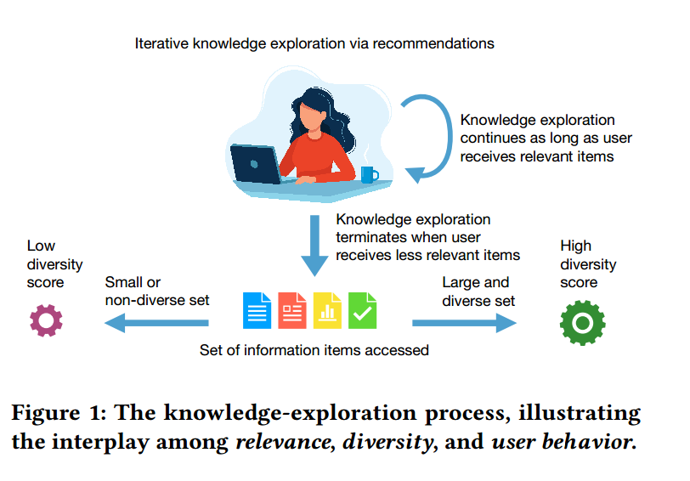
ChongqingUniversity of Technology
ATAI
AdvancedTechniqueof
Artificial Intelligence
ATAI
ChongqingUniversity _{AdvancedTechniqueof}
of Technology Artificial Intelligence
Overview

Slide 4
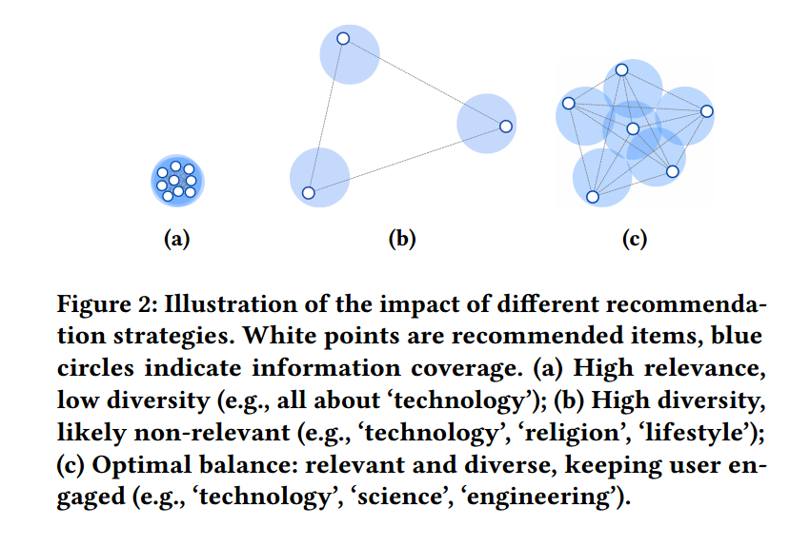
ChongqingUniversity of Technology
ATAI
AdvancedTechniqueof
Artificial Intelligence
ATAI
ChongqingUniversity _{AdvancedTechniqueof}
of Technology Artificial Intelligence
Overview

Slide 5

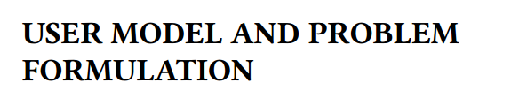

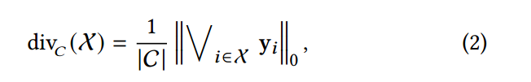
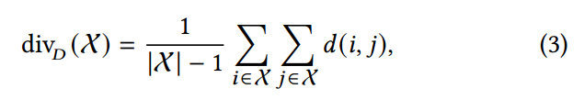
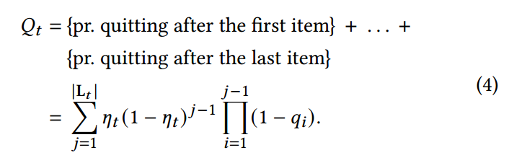

ChongqingUniversity of Technology
ATAI
AdvancedTechniqueof
Artificial Intelligence
ATAI
ChongqingUniversity _{AdvancedTechniqueof}
of Technology Artificial Intelligence
Method

Slide 6
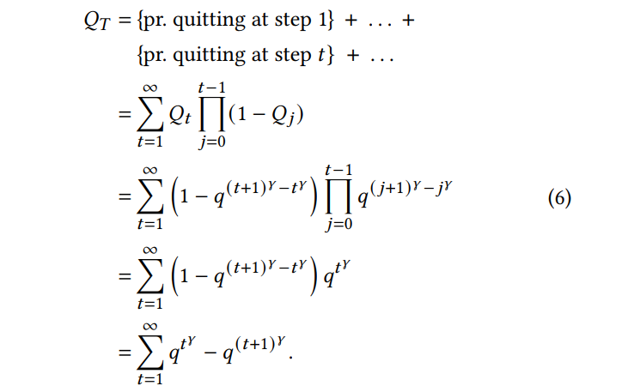
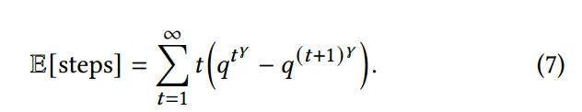

ChongqingUniversity of Technology
ATAI
AdvancedTechniqueof
Artificial Intelligence
ATAI
ChongqingUniversity _{AdvancedTechniqueof}
of Technology Artificial Intelligence
Method

Slide 7


ChongqingUniversity of Technology
ATAI
AdvancedTechniqueof
Artificial Intelligence
ATAI
ChongqingUniversity _{AdvancedTechniqueof}
of Technology Artificial Intelligence
Method

Slide 8

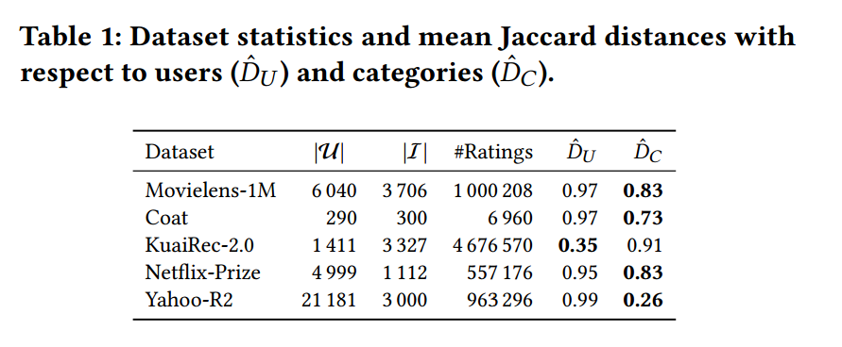
ATAI
AdvancedTechniqueof
Artificial Intelligence
ATAI
ChongqingUniversity _{AdvancedTechniqueof}
of Technology Artificial Intelligence
ChongqingUniversity of Technology
Experiments

Slide 9
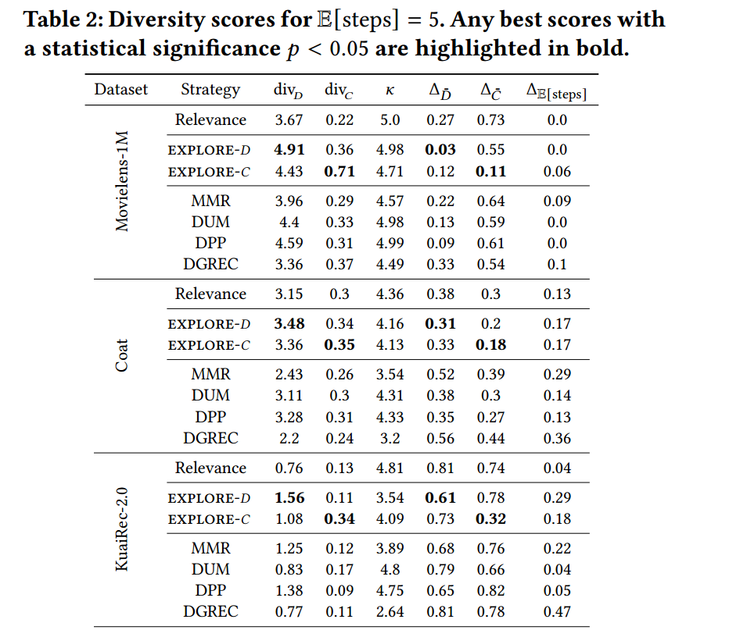
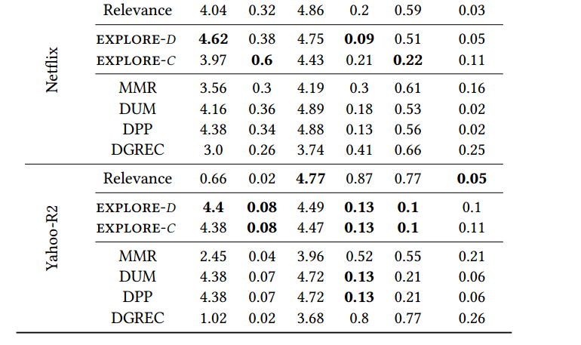
ATAI
AdvancedTechniqueof
Artificial Intelligence
ATAI
ChongqingUniversity _{AdvancedTechniqueof}
of Technology Artificial Intelligence
ChongqingUniversity of Technology
Experiments

Slide 10
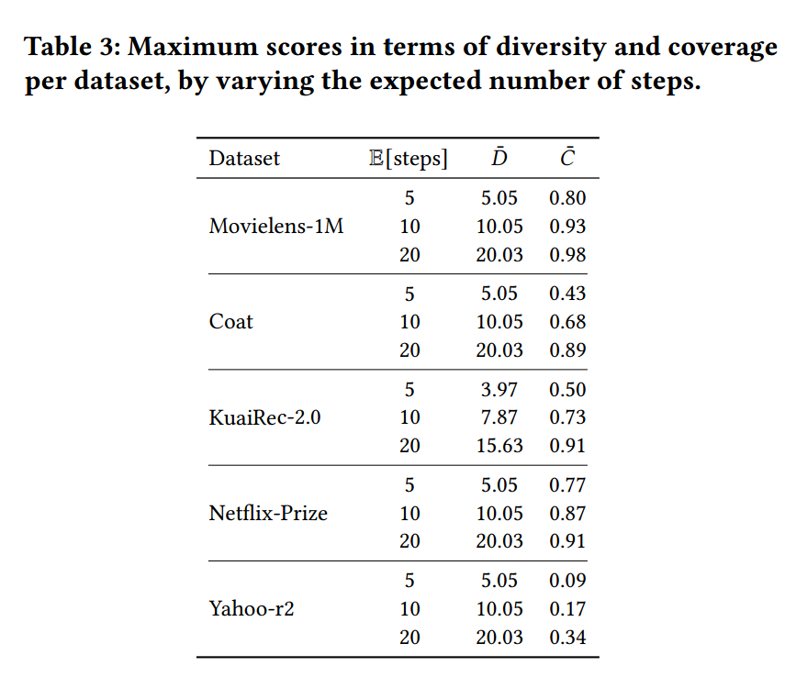
ATAI
AdvancedTechniqueof
Artificial Intelligence
ATAI
ChongqingUniversity _{AdvancedTechniqueof}
of Technology Artificial Intelligence
ChongqingUniversity of Technology
Experiments

Slide 11
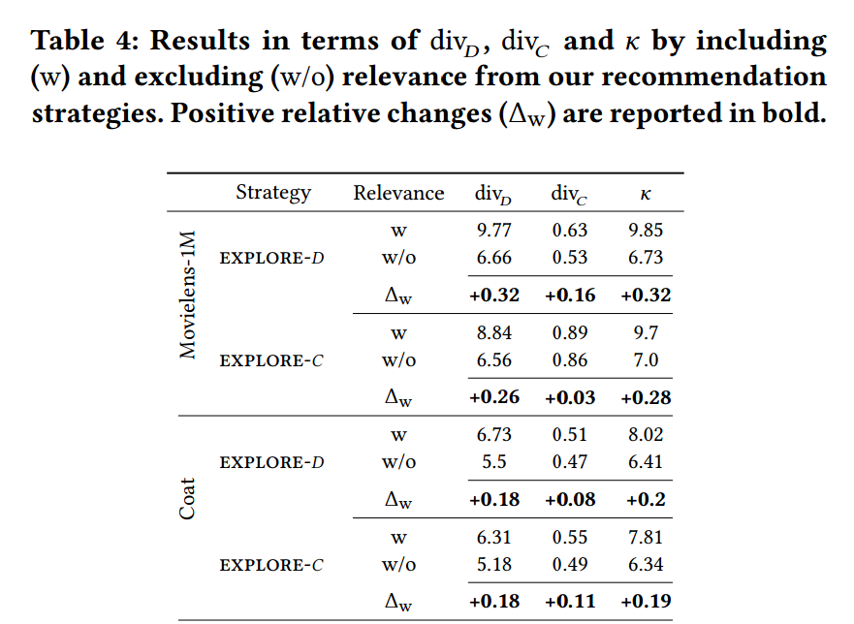
ATAI
AdvancedTechniqueof
Artificial Intelligence
ATAI
ChongqingUniversity _{AdvancedTechniqueof}
of Technology Artificial Intelligence
ChongqingUniversity of Technology
Experiments

Slide 12

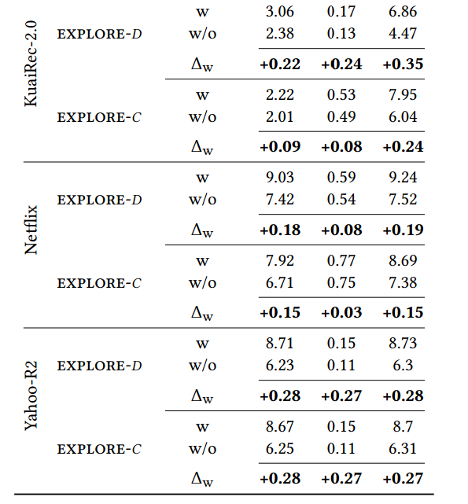
ATAI
AdvancedTechniqueof
Artificial Intelligence
ATAI
ChongqingUniversity _{AdvancedTechniqueof}
of Technology Artificial Intelligence
ChongqingUniversity of Technology
Experiments

Slide 13
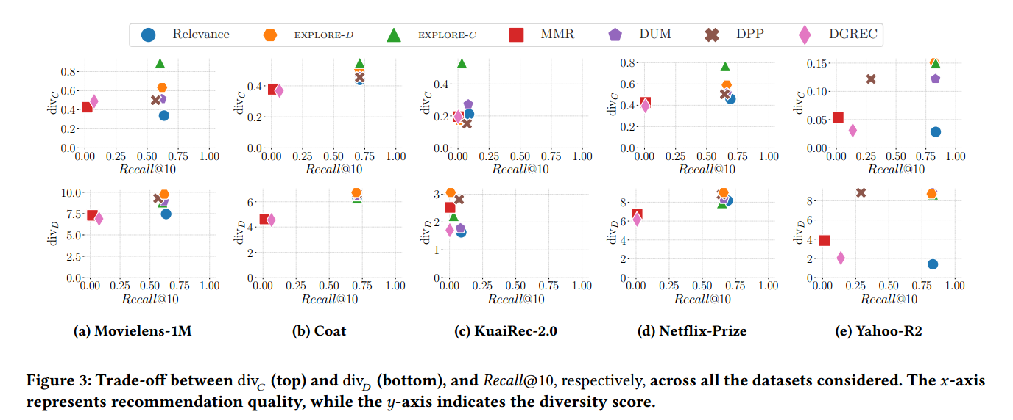
ATAI
AdvancedTechniqueof
Artificial Intelligence
ATAI
ChongqingUniversity _{AdvancedTechniqueof}
of Technology Artificial Intelligence
ChongqingUniversity of Technology
Experiments

Slide 14
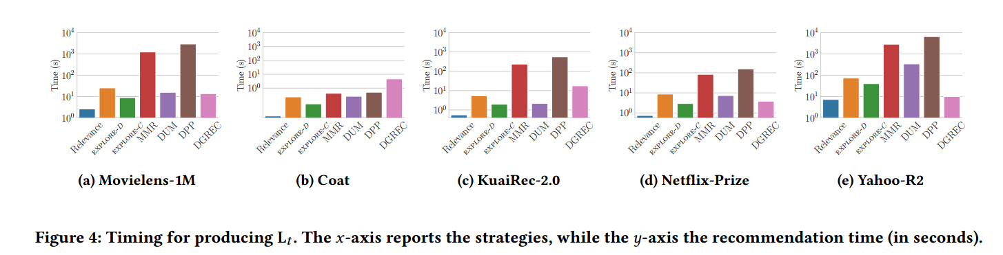
ATAI
AdvancedTechniqueof
Artificial Intelligence
ATAI
ChongqingUniversity _{AdvancedTechniqueof}
of Technology Artificial Intelligence
ChongqingUniversity of Technology
Experiments

Slide 15


ChongqingUniversity of Technology
ATAI
AdvancedTechniqueof
Artificial Intelligence
ATAI
ChongqingUniversity _{AdvancedTechniqueof}
of Technology Artificial Intelligence
Thanks!

